Slide 1
Ameren Illinois Energy Efficiency Programs
Market Development Initiative Overview

Slide 2
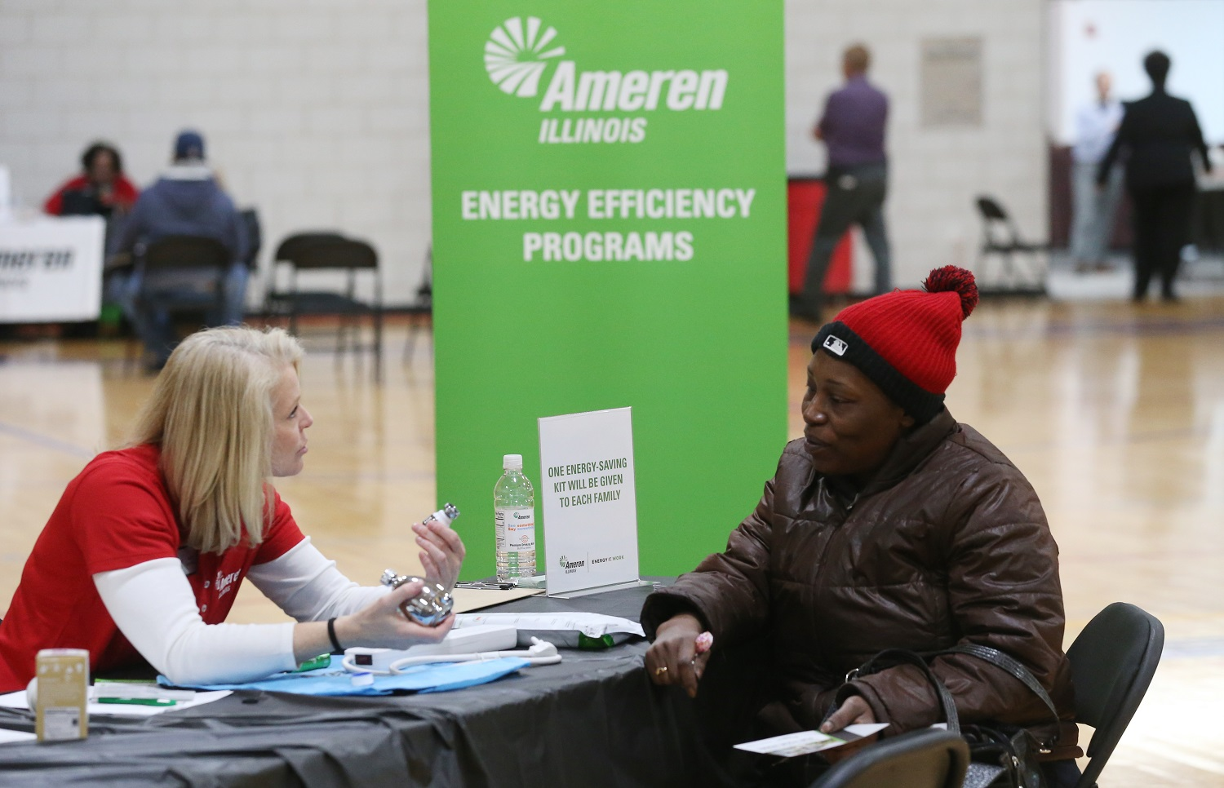
What is the Market Development Initiative?
Increase energy efficiency engagement by customers who have not participated
Increase the number of local, diverse candidates filling untapped energy efficiency jobs
Expand or launch new local, diverse energy efficiency businesses
By partnering with local community organizations to connect people and businesses with new energy efficiency upgrades, jobs, and business opportunities
For example, working with community organizations to create internships that train those in the local population to install energy savings upgrades in homes and businesses

Slide 3
How it Started
Beginning in 2018, and in accordance with the Final Order of the Illinois Commerce Commission (ICC) issued Docket No. 17-0311, Ameren Illinois Company dedicated $2.9 million for the Ameren Illinois Energy Efficiency Program Market Development Initiative (MDI)
MDI closely integrates with both the Business and Residential Program on day-to-day operations and customer interactions, helping to identify more project opportunities, maximize customer touchpoints, and create a streamlined process for Program participation
MDI was created to cultivate new economic and energy efficiency opportunities for diverse individuals and communities residing in the Ameren Illinois service territory
Together, the Ameren Illinois Energy Efficiency Program and MDI will achieve Energy Efficiency for All

Slide 4
How it Works
Partnerships with existing local community organizations are developed to connect people and businesses with new energy efficiency measures, jobs, and business opportunities
Creates an environment of support for Community Partners including:
Project management
Cybersecurity processes that alleviate the data burden for them
Invoicing templates and ongoing support, central resource page with all project materials and education
Ongoing webinars and newsletters
Data entry support for tracking outcomes in the central database
Event and webinar planning support including hosting and coordination
Marketing and collateral design
Drafting implementation plans and contracts
Forecasting

Slide 5
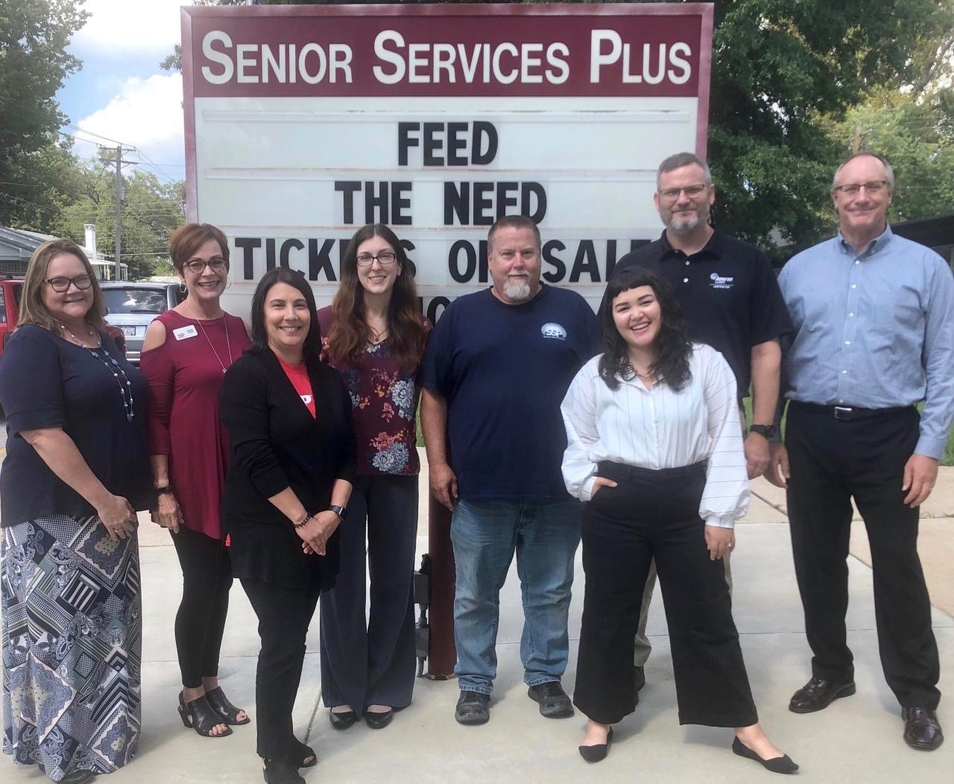
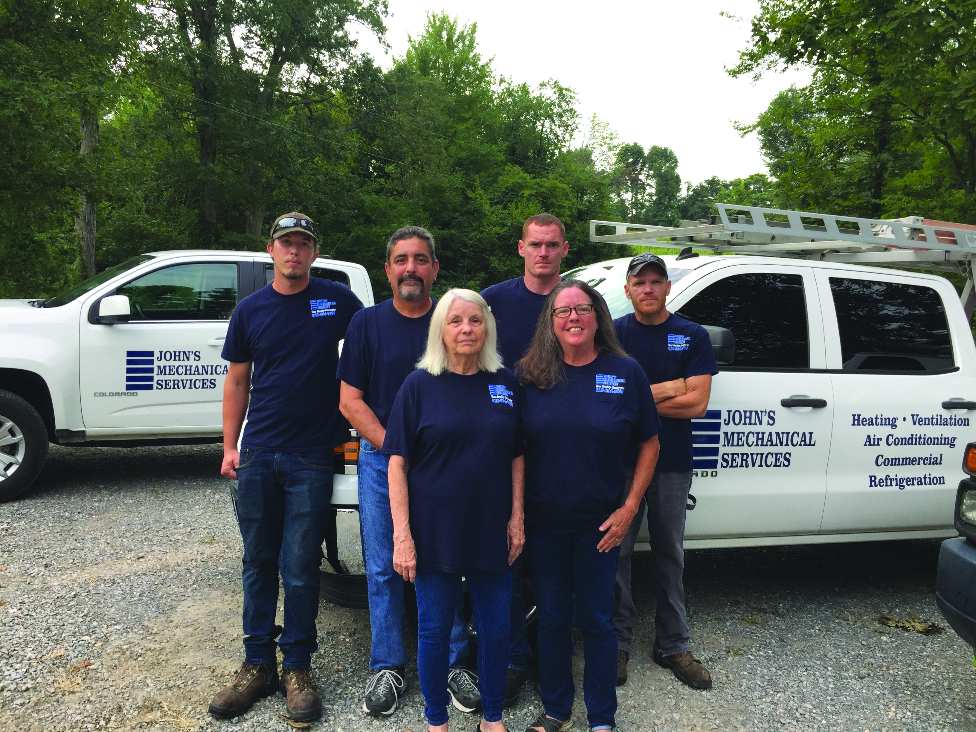
Partnerships
Community Based Organizations
Community Action Agencies
Program Allies

Slide 6
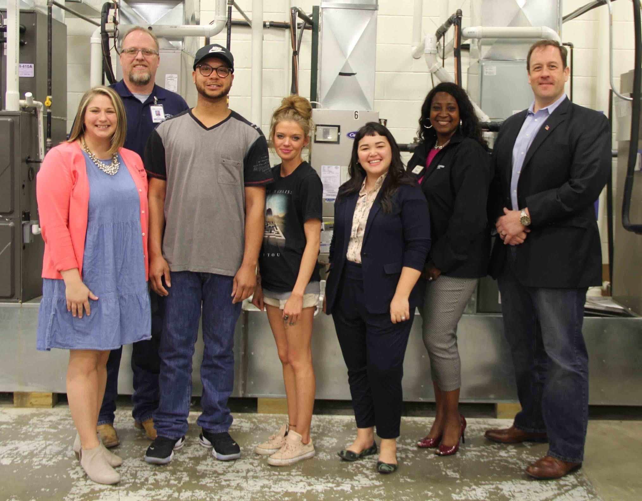
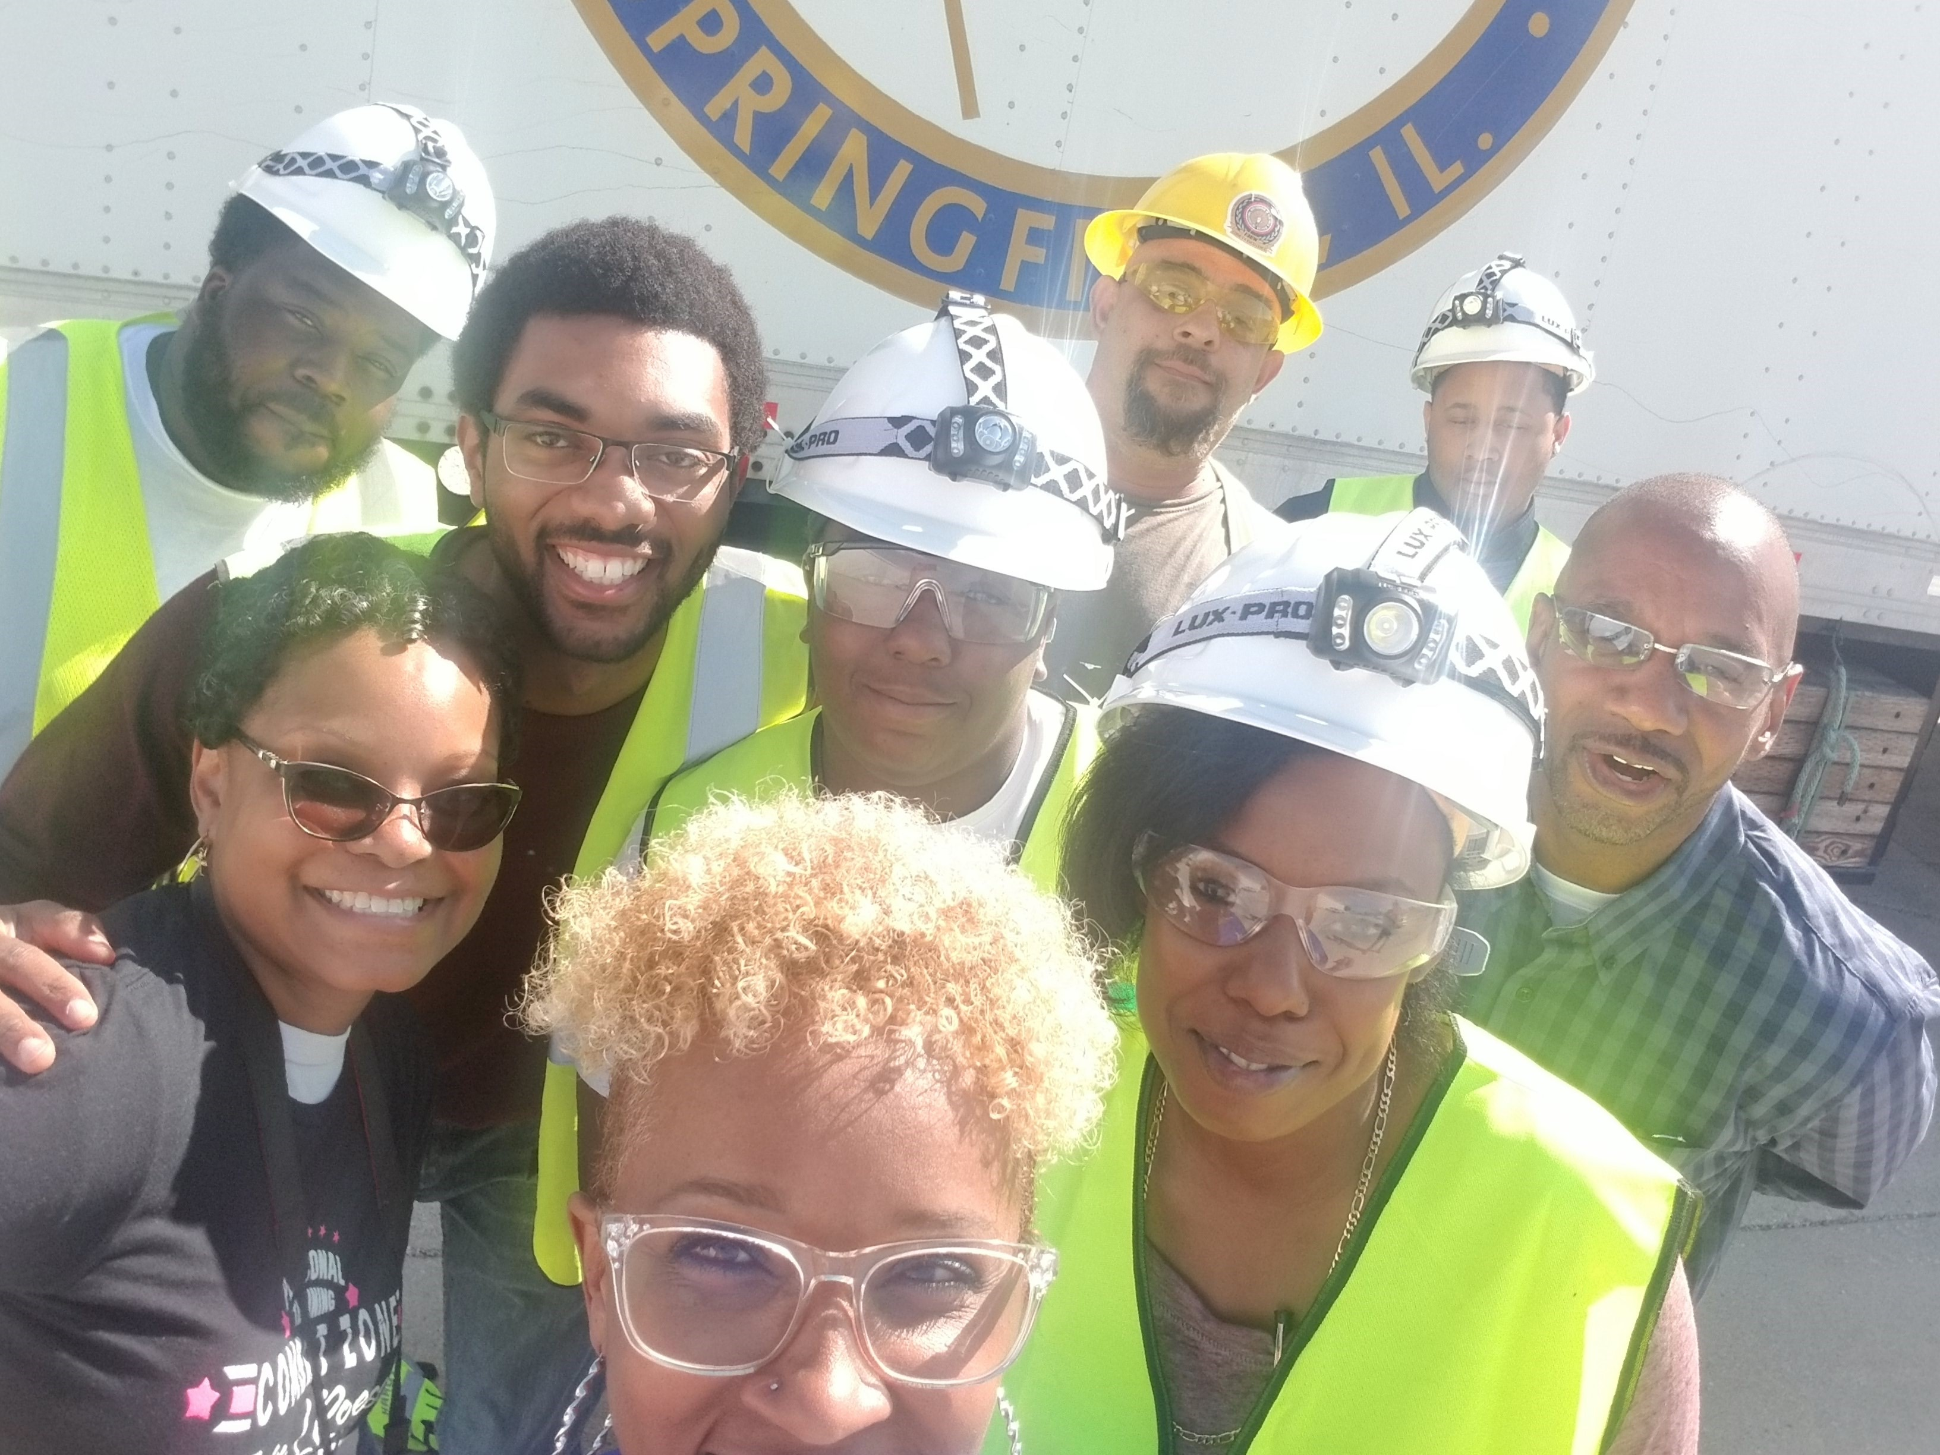
Efforts to Reach Underserved Customers
Partnering with local agencies on outreach efforts
Examples: CAAs, Easterseals, and Friends of Central Illinois
Providing resources to local, diverse Program Allies
Examples: Minority Business Development Center and equipment grants
Providing education to individuals interested in energy efficiency as a career
Examples: internships and school age workforce education
Expand definition of underserved to include:
Low income
Racial minorities
Veteran
People with disabilities
The more you can narrow the audience you're reaching the more you can cater the project and the Partner's efforts to that specific needs

Slide 7
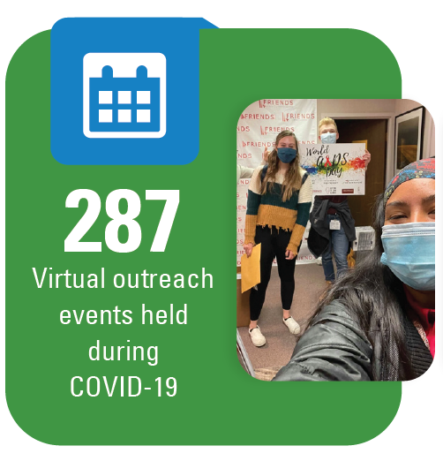
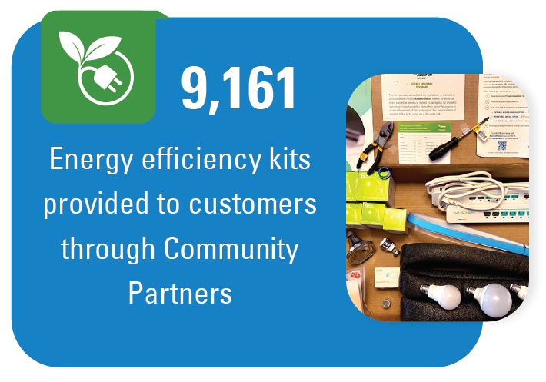
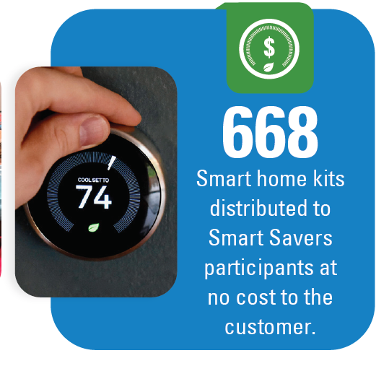
2020 Impacts

Slide 8
Questions?
AmerenIllinoisSavings.com/MDI

